Slide 1
Machina-Ex-Kaggle
Sam Audino, Charles Cohen, Michael Dollar & Michael Drozdov

Slide 2

Procedure
Data Cleaning
Analysis and Interpretation
Feature Engineering
Feature Selection
Modelling
Stacking
Conclusion

Slide 3
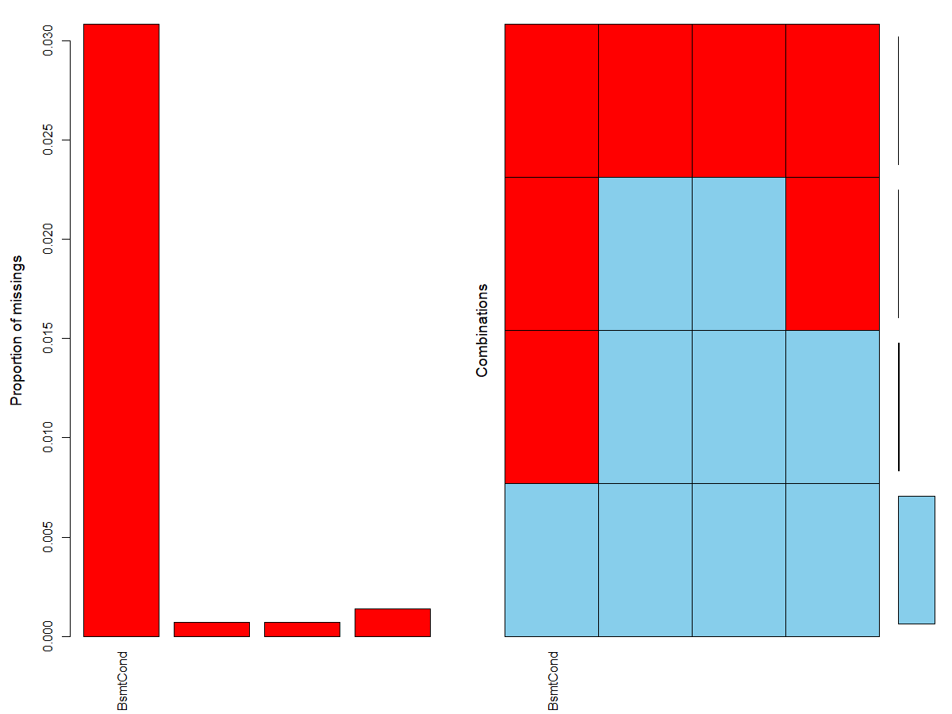
Data Cleaning - Following Clues...
We’ll take a look at the Basement categories as an example of our process of imputing missing values.
We can see that there is a strong correlation between NAs in the BsmtUnfSF, TotalBsmtSF, and BsmtFullBath, and the BsmtCond columns. A missing in BsmtCond almost implies the non-existance of the basement, since whether or not a listing has a basement isn’t an explicit feature of our dataset. We can see from VIM’s aggr function that these elements line up to have consistently missing features. This allows us to impute 0s onto BsmtUnfSF, TotalBsmtSF, and BsmtFullBath
BsmntUnfSF
TotalBsmtSF
BsmtFullBath
BsmntUnfSF
TotalBsmtSF
BsmtFullBath
Notes:
Dollar

Slide 4
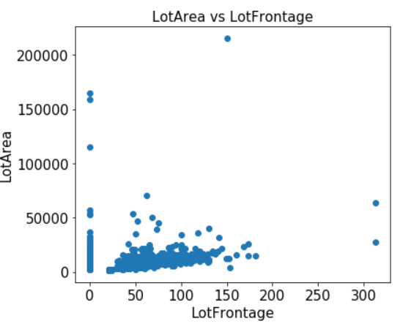
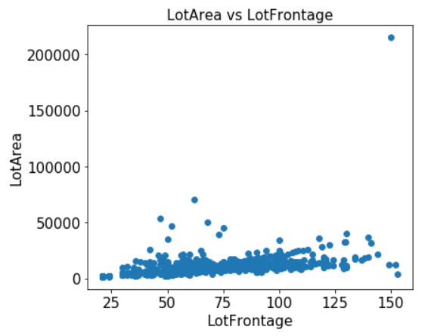
Imputation
Before
There are many hints in the dataset that allow us to impute missing values with reasonable estimates; we’ll highlight a couple of strategies that we used.
For LotFrontage, we noticed that it is heavily correlated with LotArea, so using a simple linear regression we were able to impute the data to give a more effective estimate of the frontages of the property. The thinking behind this is that area is made from length and width, so the property has to have some kind of ‘front’ of the property.
Imputing with 0
After
Notes:
Mike $$

Slide 5
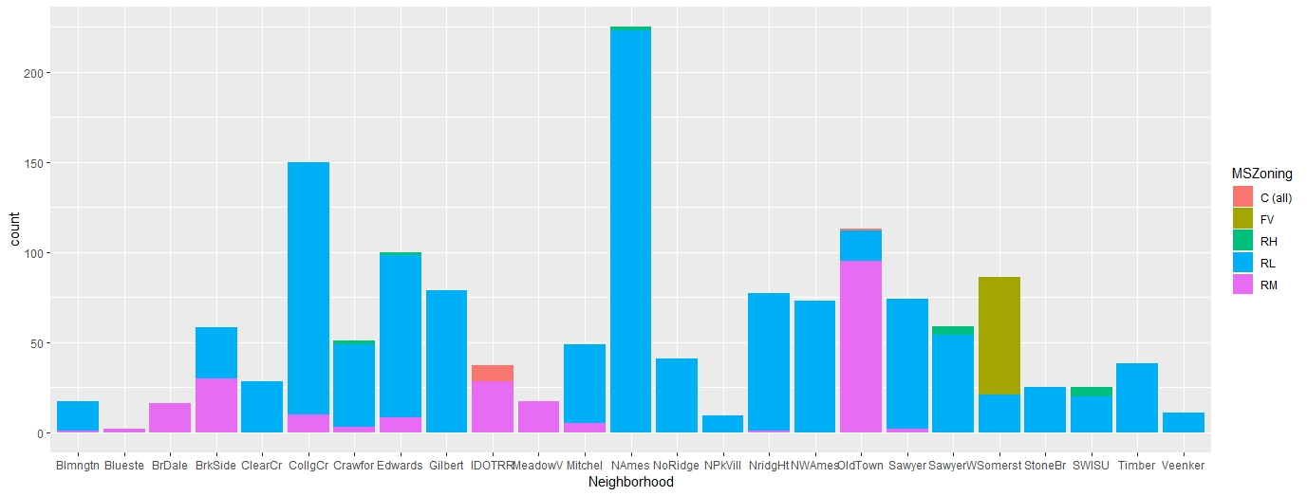
Making Choices...
For a few categorical MCAR values, a bit of intuition was used to select a related column for clues for the best imputation choice. An example would be the feature MSZoning. The observation from which the MSZoning value was missing had a value of NAmes for Neighborhood. That category almost always RL for MSZoning.

Slide 6
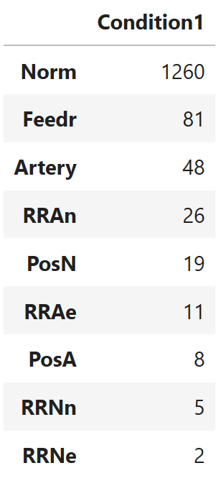
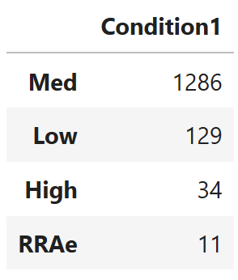
Feature Engineering
Categorical Binning
ML looks for similarities in the Train and Test Data to make its predictions.
But what do we do when values are present in one, but not the other??
What about when values are so infrequent, we can get any information out of them?
Bin by Median Response
This is the method we choose.
We binned columns like these by median sale price.
This has the least impact on overall distribution, while significantly reducing computation complexity
Notes:
Sam

Slide 7
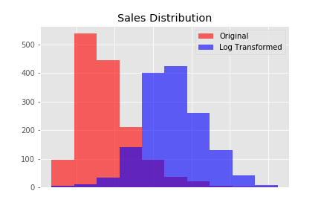
Response Engineering
When the response variable is skewed (leans too far to the left or right), it makes our predictions much more difficult.
In a way, we are weighing our dataset towards that left peak. When we want to be centered around the mean.
By taking the log transform of the sales price, we correct that skewing, and are well on our way to improving our predictive capability
Notes:
Charlie

Slide 8
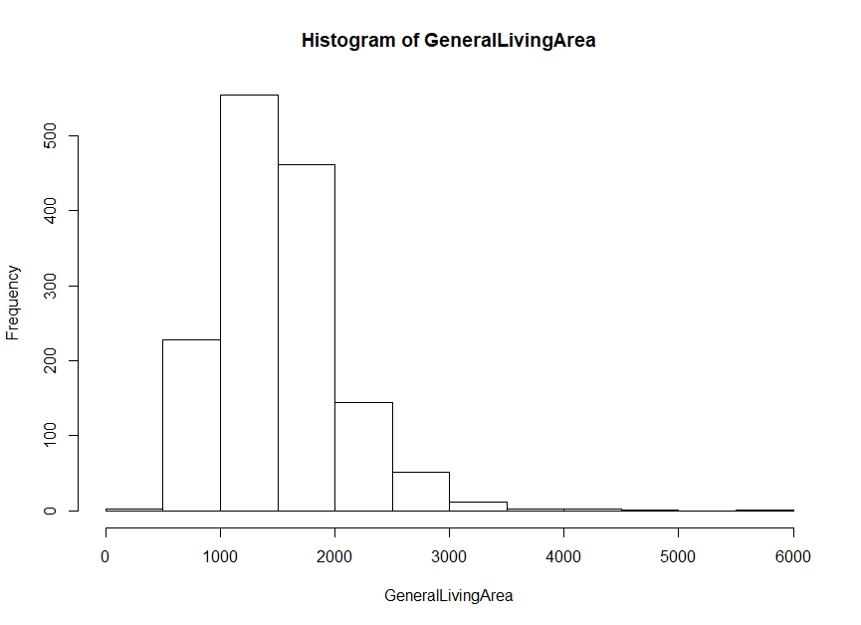
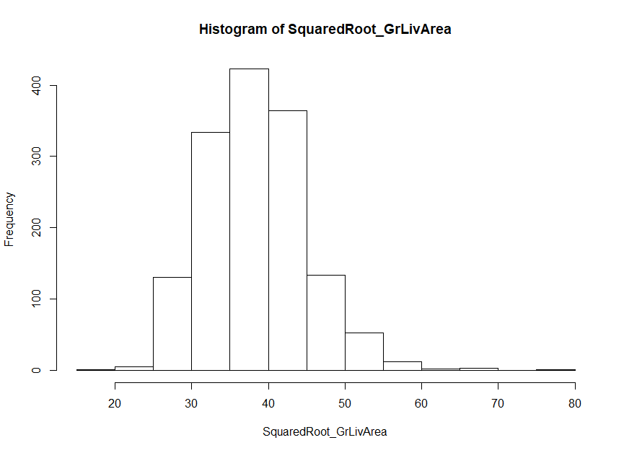
Normalization
The majority of the data was skewed either right or left. In order to normalize it, we used a square root transformation.
Many features are in Square Feet, so it seemed like a natural choice
On features like GrLivArea, square root transformation performed slightly better than log transformations.
It’s important to remember that not all numeric columns need to be normalized, as things like how many bathrooms a house has would not benefit from being transformed.
HIST of GrLivArea transformation
Notes:
Drozdov

Slide 9
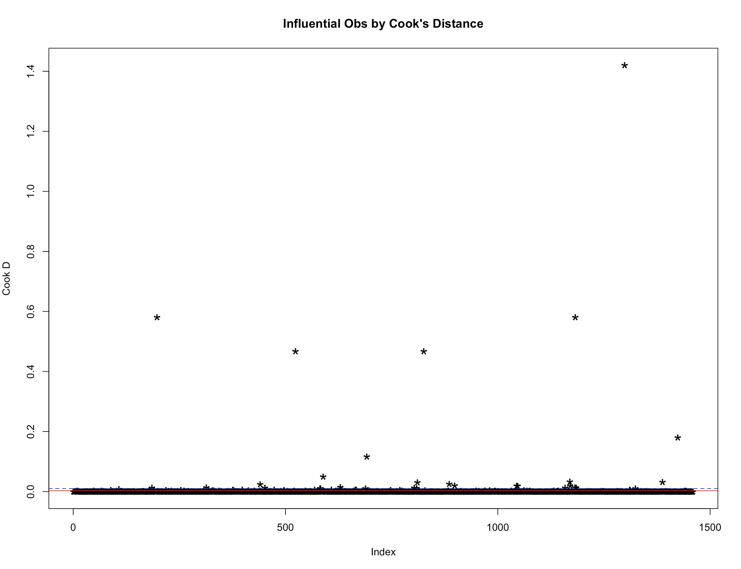
Outliers
Outliers impact the ability of a model to properly interpret and fit the data.
Cook’s distance shows the influence of each observation on the fitted response values.
A standard cut-off point for influential points is 4/n where n is the sample size. Another standard cut off is 3 times the mean of all cook’s distances.
The two cut off measures tend to be similar with a large sample size.
Removing the outliers improved the fit of our model in both in and out-of sample tests.
Notes:
Drozdov

Slide 10

Feature Selection
Lasso was the main source of feature selection
Lasso allowed us to easily identify unnecessary columns, reducing our model’s complexity by one-fourth.
Before passing the Lasso the data, we made sure to dummy all categorical columns (led to most accurate score)
We also tried turning columns into ordinals, and scaling the ordinals to between 0 and 1 based on the spread of there median prices using:
Notes:
Sam

Slide 11

Modelling: Hyperparameter Tuning
Alpha Tuning
While all of our tests suggested that the smaller the alpha the better. Our best results were obtained using:
Lasso improves on Linear Regression due to Regularization. The alpha parameter weights the coefficients by importance.
For a large Alpha, all the coeff. become 0
For a small Alpha, the coeff. stay about the same.
Notes:
Charlie

Slide 12
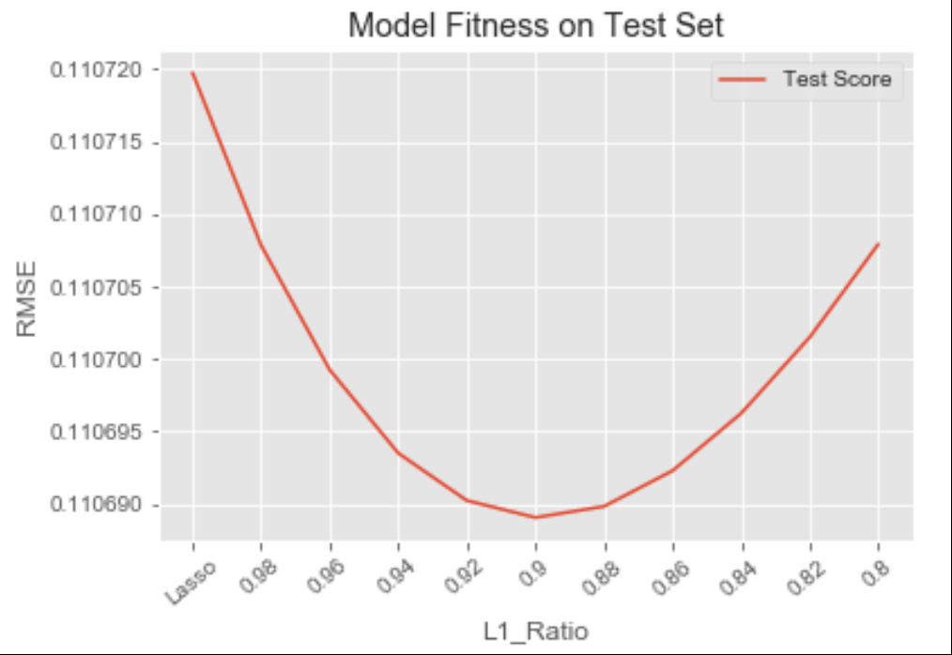
Modelling: Hyperparameter Tuning
L1 Ratio Tuning
We found that an L1 Ratio of 0.9 results in the best RMSE score over the testing subset.
An ElasticNet Model is a combination of the standard Ridge and Lasso Models.
The L1 Ratio is balance between the Lasso and Ridge Penalty Terms.
Notes:
Charlie

Slide 13
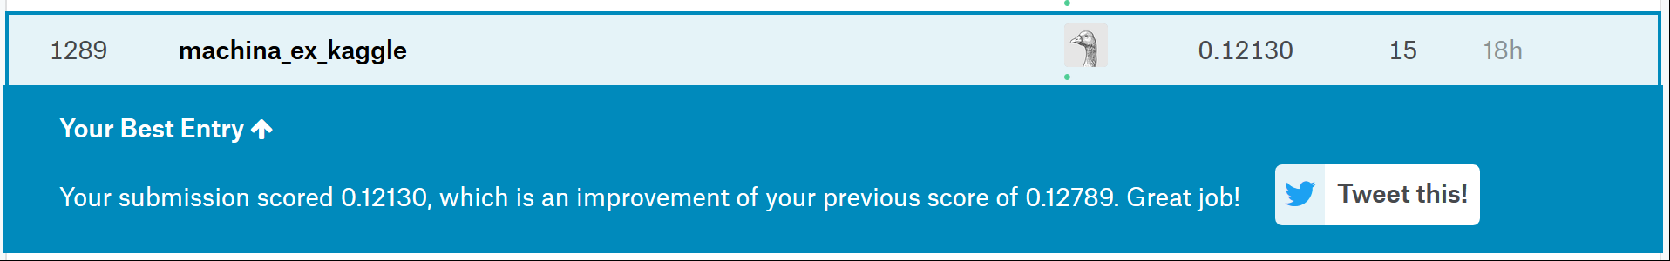
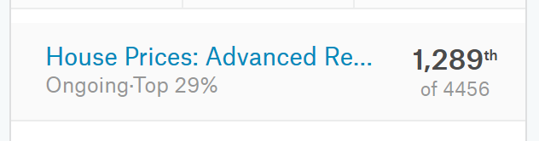
Kaggle Submission
Notes:
Mike

Slide 14
Stacking: An Attempt
We attempted to implement a model stacking method with the following logic:
Split training subset into n subsets using KFold
Tune an ElasticNet model to the current KFold
Make predictions on the next KFold
Add those predictions to the next KFold as a feature
Set next KFold as current KFold, return to step 2 unless this is the last KFold
Make prediction on the full training data and the full test data.
7. Use those new highly tuned features to improve accuracy of the model.
The problem was that while we would be able to reduce the log RMSE of the training sets, it did not translate to a big improvement in score on the actual Kaggle submission.
Notes:
Sam

Slide 15
Future Steps
Stacking Method
Use more models beyond ElasticNet
Mix other ensemble methods
weighted average ...
Feature Engineering
Experiment with other data transformations
Boxcox, Log
Data Cleaning
More Aggressive Data Cleaning
Removal of certain features/obs
Find more dependencies/collinearity
Second star to the right, and straight on til morning.
Notes:
All of us

